Slide 1
Statistics 367-1-4361 Linear Models
Opher Donchin

Slide 2
8.1 Bivariate data
Examples of how two variables can be related

Slide 3
What we've learned so far
The course has built a chain of ideas, tools, and model families
Fundamental concepts
Computational approach
Applications
Data and models
Binomial models
probabilities
1
6
Sampling
4
Hierarchical models
structured data
Bayes law
7
2
Normal models
continuous data
8
Posterior
Workflow
3
5
Regression models
multivariate data
9
Today
What uncertainty means and how evidence updates models
How we compute posteriors and check whether we should trust them
Different data structures; same Bayesian logic

Slide 4
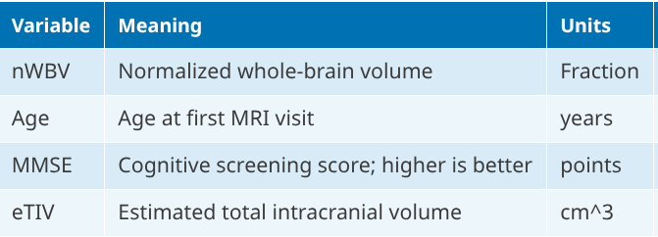
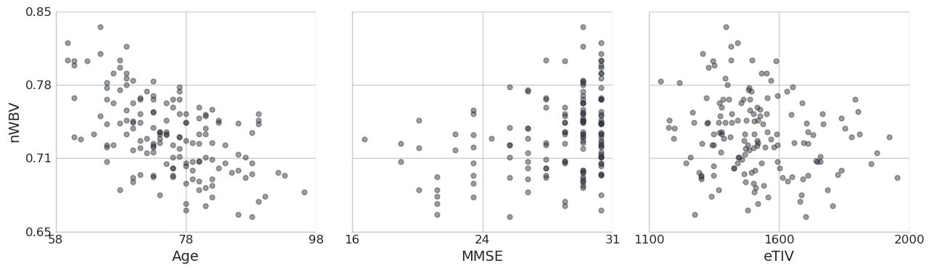
Todays models relate age, brain volume, and cognitive function
Characterize
Estimate parameters
Assess effect sizes
Make inferences

Slide 5
8.2 The bivariate model
Independent variables, dependent variables, linear model, shared variance

Slide 6
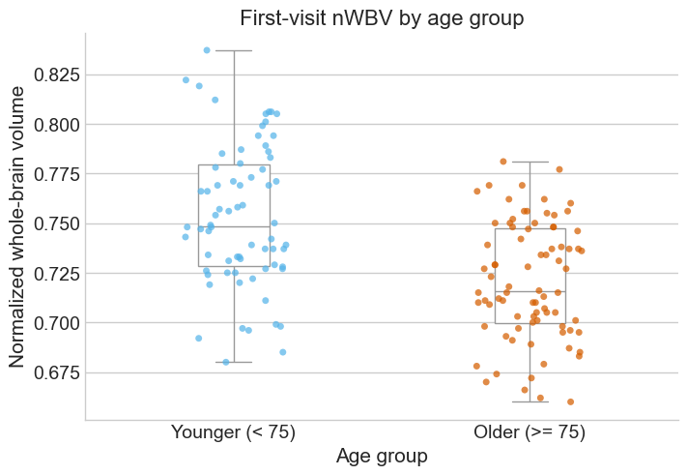
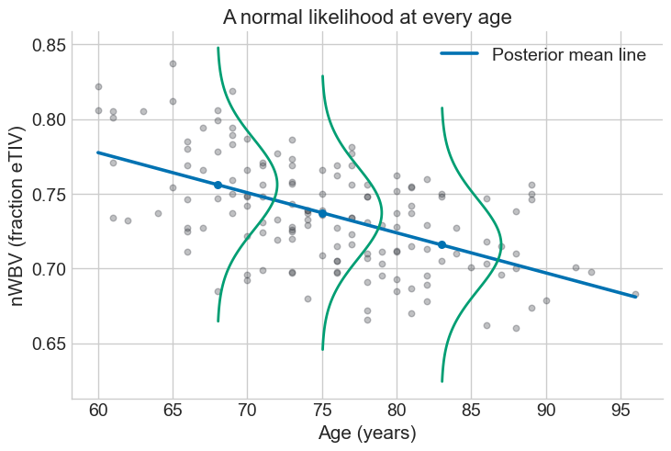
Generalizing the two group normal model
In two group model
Each data point had one of two means
In bivariate model
Each data point has its own mean

Slide 7
Linear regression has a normal likelihood
Each data point has its own mean
And the equation for the mean is linear
And they share a standard deviation

Slide 8
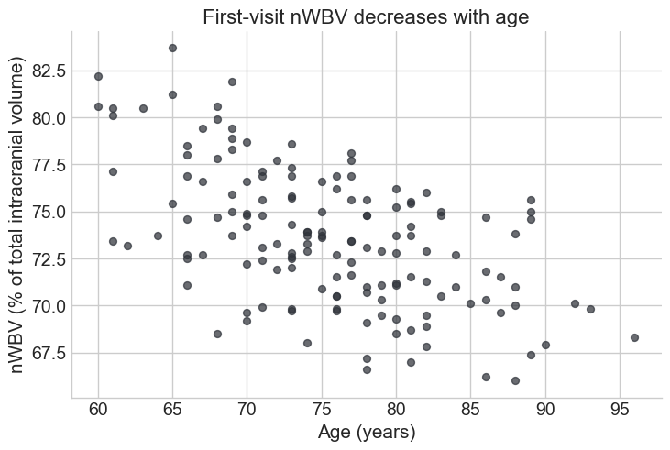

There is an asymmetry in the model
x: independent variable
Assumed to be known precisely
y: dependent variable
Measured with noise
Implied underlying causal structure
This is called a DAG and they are used to show causal relationships between variables

Slide 9
There is an asymmetry in the model
x: independent variable
Assumed to be known precisely
y: dependent variable
Measured with noise
It can make sense
Age affects brain volume
It can be arbitrary
Cognitive test and motor skill test
Brain volume and education level

Slide 10
We translate the formal idea into a graphical model
We have the likelihood
We need priors

Slide 11
From graphic model to PyMC
Automatic broadcasting:
Age, mu and nwbv all have the same dims
with pm.Model(coords=coords_age) as nwbv_age_model:
Age_data = pm.Data("Age_data", age_data, dims="obs_id")
beta0 = pm.Normal("beta0", mu=mu_0, sigma=sigma_0)
beta1 = pm.Normal("beta1", mu=mu_1, sigma=sigma_1)
sigma = pm.HalfNormal("sigma", sigma=sigma_sigma)
mu = pm.Deterministic("mu", beta0 + beta1 * Age_data, dims="obs_id")
nwbv_obs = pm.Normal("nwbv_obs", mu=mu, sigma=sigma, observed=nwbv_data, dims="obs_id")

Slide 12
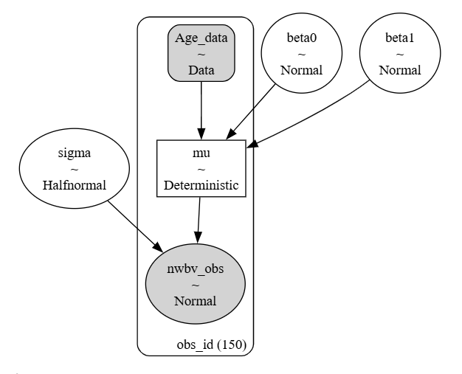
From PyMC to graphic representation
Sanity check for the model
with pm.Model(coords=coords_age) as nwbv_age_model:
Age_data = pm.Data("Age_data", age_data, dims="obs_id")
beta0 = pm.Normal("beta0", mu=mu_0, sigma=sigma_0)
beta1 = pm.Normal("beta1", mu=mu_1, sigma=sigma_1)
sigma = pm.HalfNormal("sigma", sigma=sigma_sigma)
mu = pm.Deterministic("mu", beta0 + beta1 * Age_data, dims="obs_id")
nwbv_obs = pm.Normal("nwbv_obs", mu=mu, sigma=sigma, observed=nwbv_data, dims="obs_id")

Slide 13
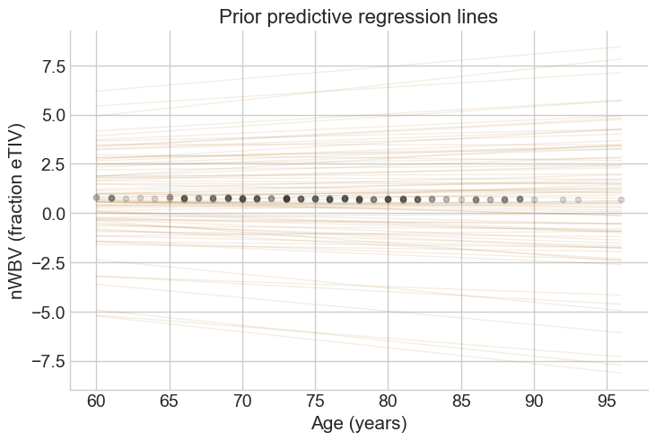
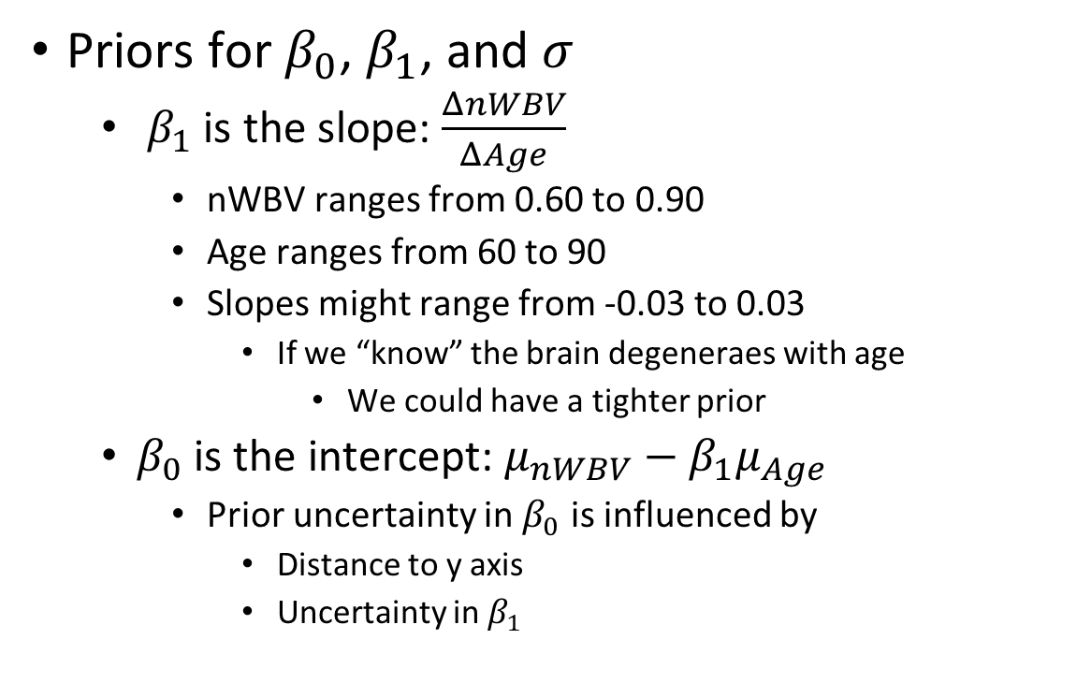
Priors for $β_{0}$ and $β_{1}$depend on regression equation
Priors for $β_{0}$, $β_{1}$, and $σ$
$β_{1}$ is the slope: $\frac{ΔnWBV}{ΔAge}$
nWBV ranges from 0.60 to 0.90
Age ranges from 60 to 90
Slopes might range from -0.03 to 0.03
If we “know” the brain degeneraes with age
We could have a tighter prior
$β_{0}$ is the intercept: $μ_{nWBV}−β_{1}μ_{Age}$
Prior uncertainty in $β_{0}$ is influenced by
Distance to y axis
Uncertainty in $β_{1}$
I will proceed with this very broad prior

Slide 14
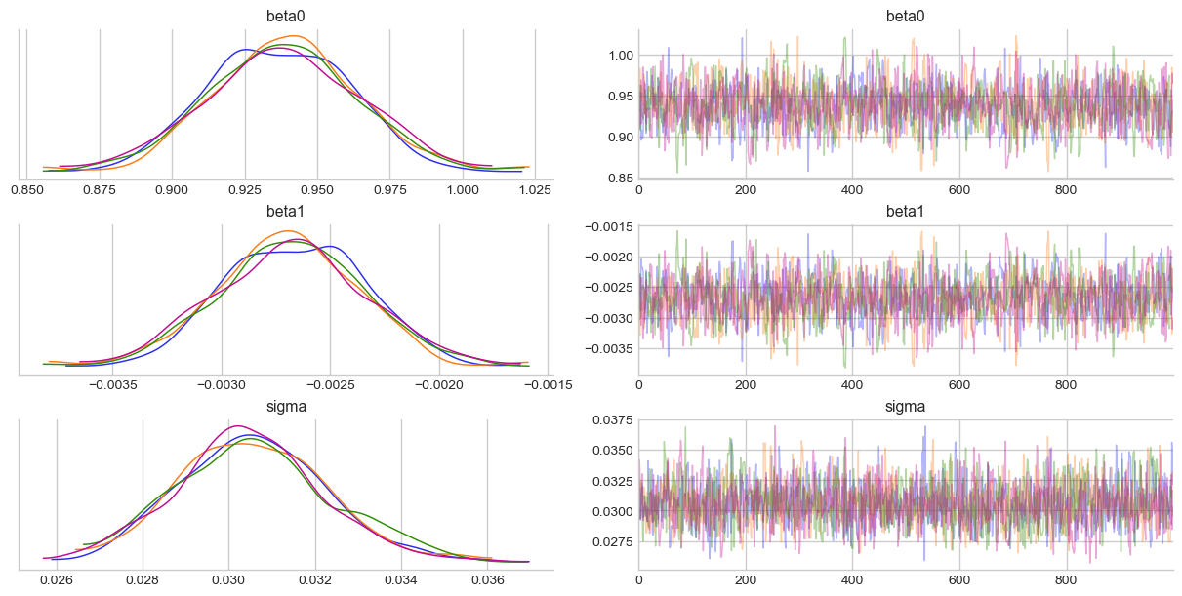
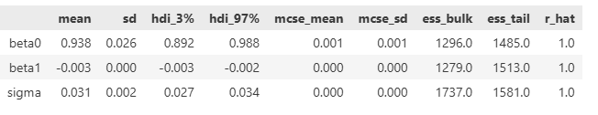
Sampling looks ok

Slide 15
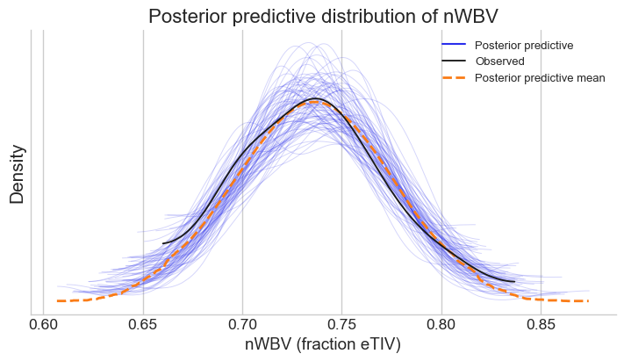
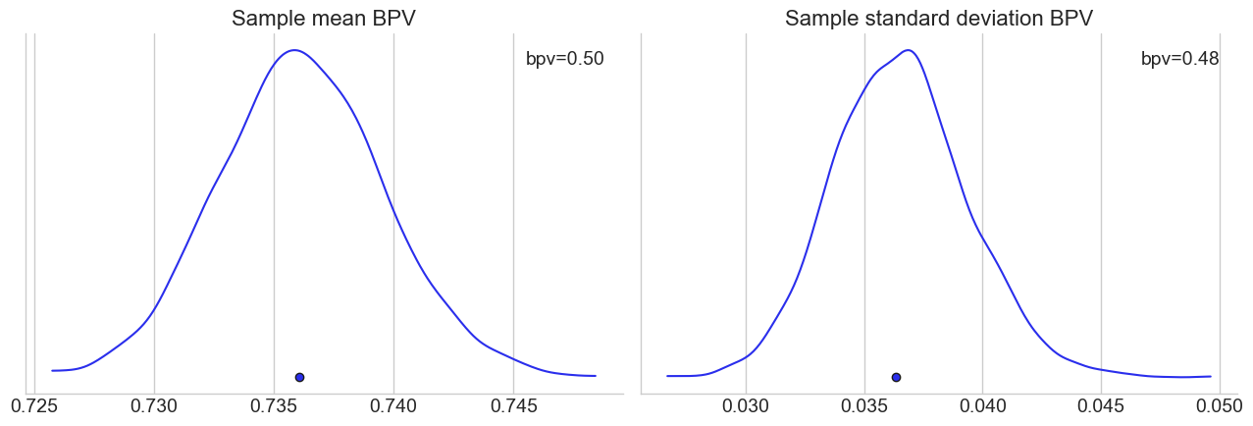
Posterior predictive distribution looks ok

Slide 16
sample_posterior_predictive can predict on new data
age_prediction_idata = sample_model_predictions(
nwbv_age_model,
nwbv_age_idata,
data_updates={"Age_data": age_grid},
coords={"obs_id": np.arange(len(age_grid))},
restore_data={"Age_data": age_data},
restore_coords={"obs_id": np.arange(len(simple_df))},
)
Need to update coords to appropriate length
Should restore original data for sanity
def sample_model_predictions(model, idata, data_updates, coords, restore_data, restore_coords, var_names):
with model:
pm.set_data(data_updates, coords=coords)
predictions = pm.sample_posterior_predictive(
idata,
var_names=list(var_names),
predictions=True,
return_inferencedata=True,
random_seed=RANDOM_SEED,
progressbar=False,
)
pm.set_data(restore_data, coords=restore_coords)
return predictions

Slide 17
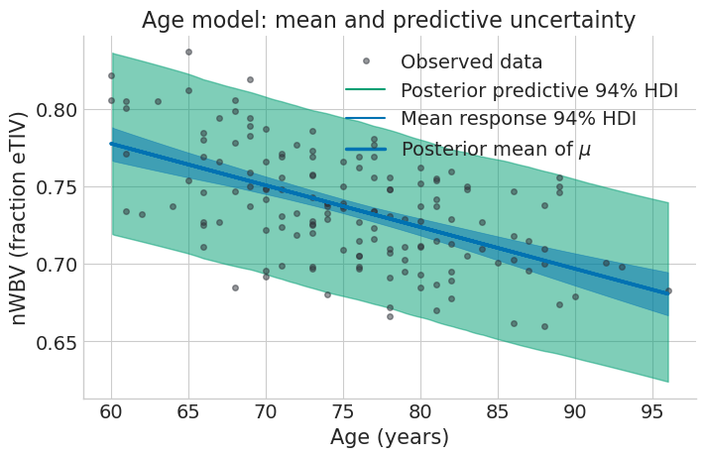
Posterior predictive shows model fit
Predictive data
Should look like original data
Center and width
Should respect model
Distance from model
Across the range

Slide 18
8.3 Posterior regression parameters
Presentation and interpretation

Slide 19
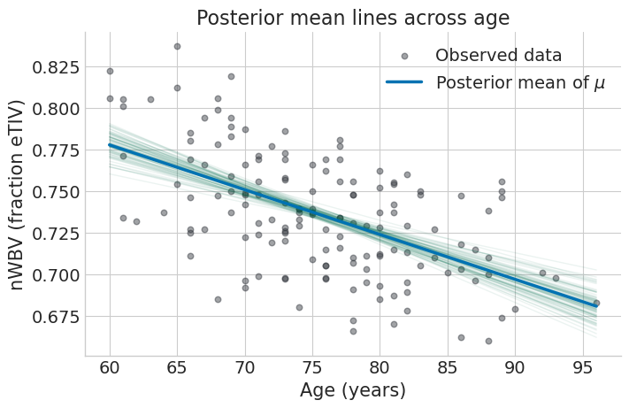
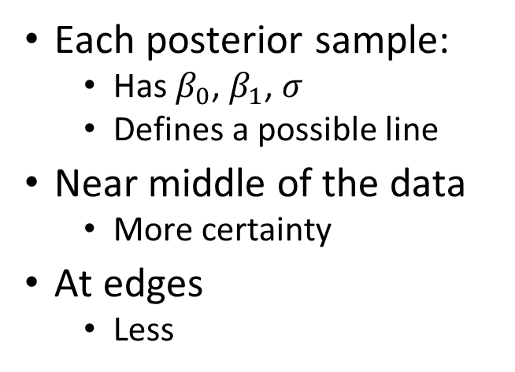
Each posterior sample is a regression line
Each posterior sample:
Has $β_{0}$, $β_{1}$, $σ$
Defines a possible line
Near middle of the data
More certainty
At edges
Less

Slide 20
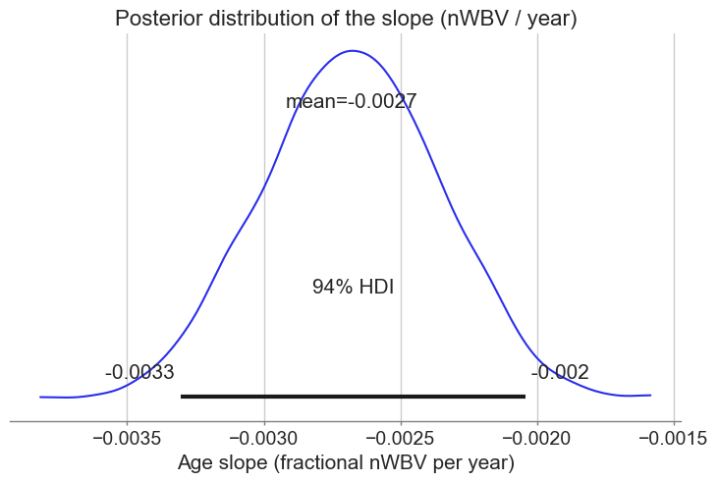
Our main interest is in the slope
Near 1% loss every 3 years
Between 0.20% and 0.33%

Slide 21
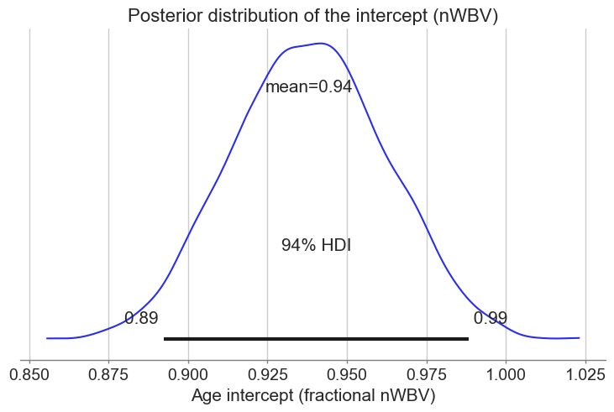
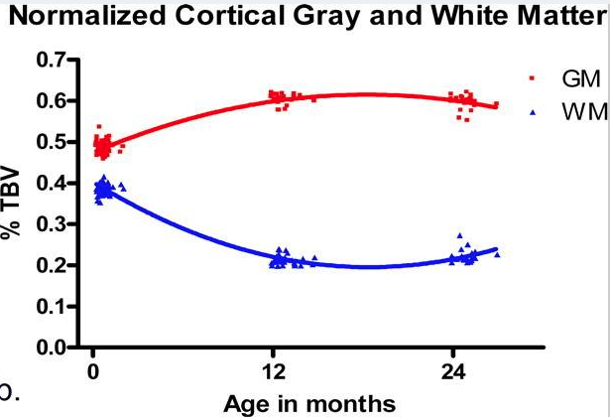
The intercept is nWBV at age 0
Model suggests brain volume at birth is 89-99% of cranial volume
Broad range
Derived from the trend between ages 60 and 90
Not necessarily relevant to other ages
Regression does not always support extrapolation
Actual nWBV for newborn infants is above 90%

Slide 22
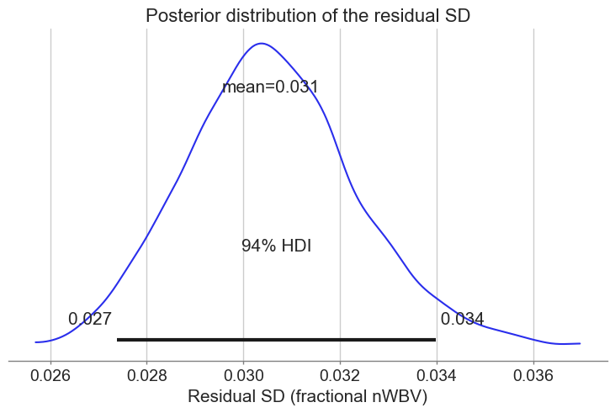
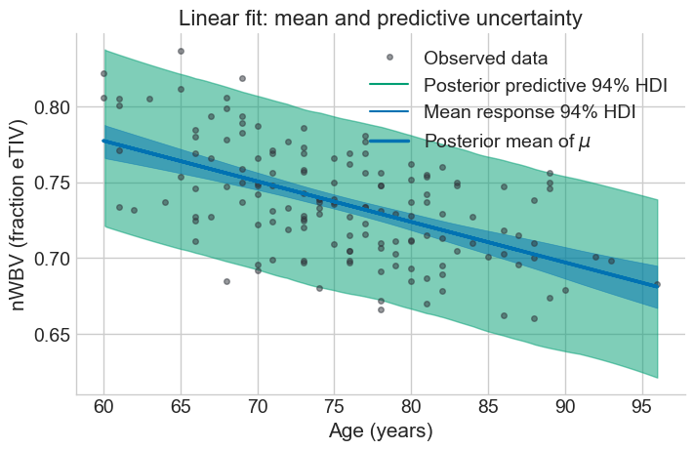
Sigma is the variability among individuals

Slide 23
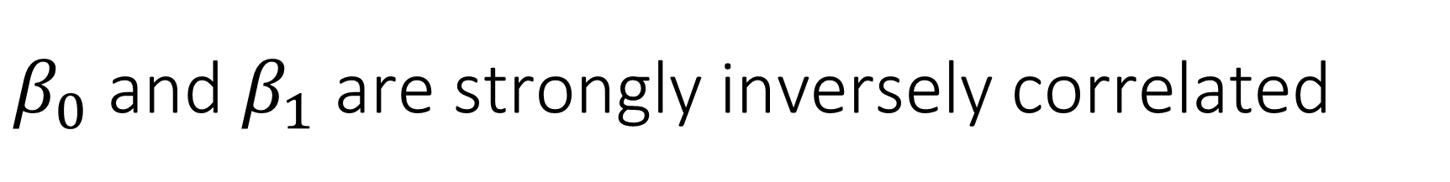
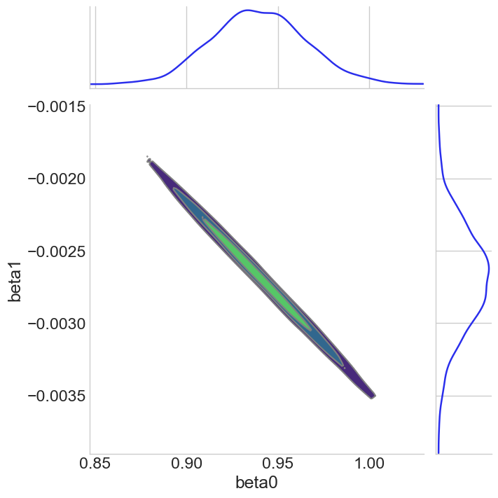
Large negative slope
High intercept
Small negative slope
Low intercept

Slide 24
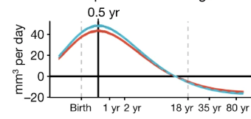
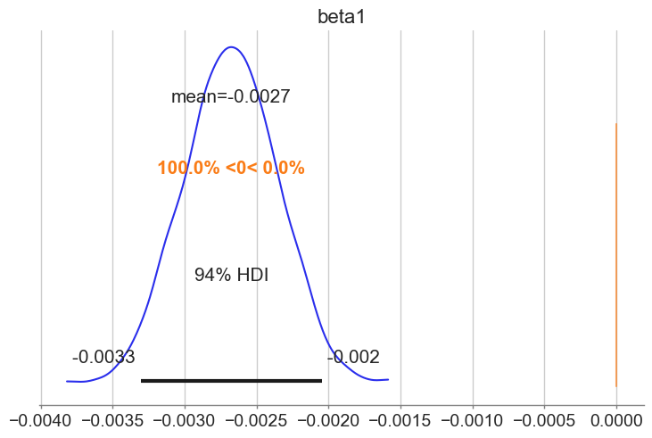
Raw effect size is the slope
Rate of change of brain volume throughout life
0.27% from a baseline of 75%
0.36% brain loss per year

Slide 25
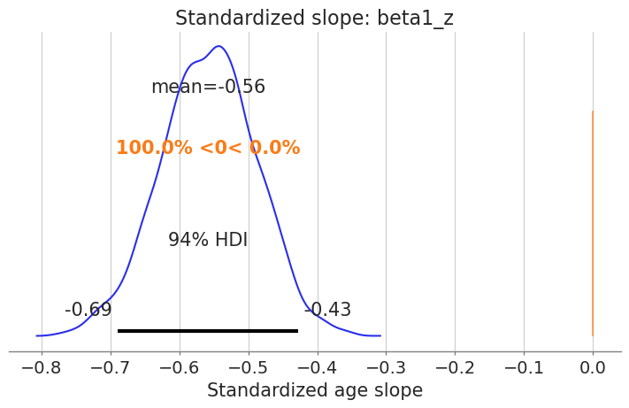
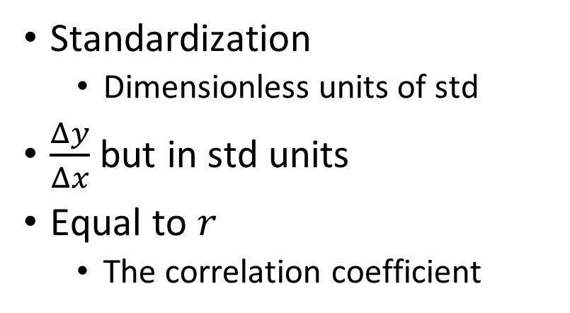
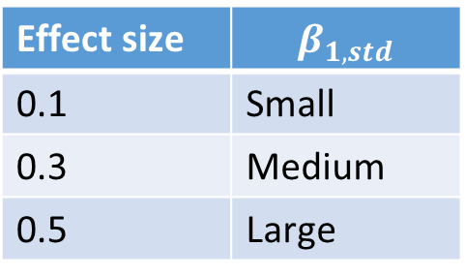
Standardized slope is a standardized effect size
Standardization
Dimensionless units of std
$\frac{Δy}{Δx}$ but in std units
Equal to $r$
The correlation coefficient
Effect size | $$β_{1,std}$$
0.1 | Small
0.3 | Medium
0.5 | Large

Slide 26
8.4 Centered and uncentered data
Moving the center to 0

Slide 27
Centering and standardization remove means and units

Slide 28
Switch the model to use a centered independent variable
Uncentered independent variable
Centered independent variable

Slide 29
The fit will be the same
We are just relabeling parameters
Uncentered independent variable
Centered independent variable

Slide 30
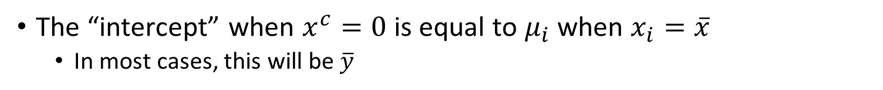

Prior for $β_{0}$ will be centered at $y\left(\overline{x}\right)$
The “intercept” when $x^{c}=0$ is equal to $μ_{i}$ when $x_{i}=\overline{x}$
In most cases, this will be $\overline{y}$
Uncentered independent variable
Centered independent variable
mu_0 = np.mean(nwbv_data) - mu_1 * np.mean(age_data)
sigma_0 = 0.5*sigma_1*np.mean(age_data)
mu_0_centered = nwbv_data.mean()
sigma_0_centered = 0.05

Slide 31
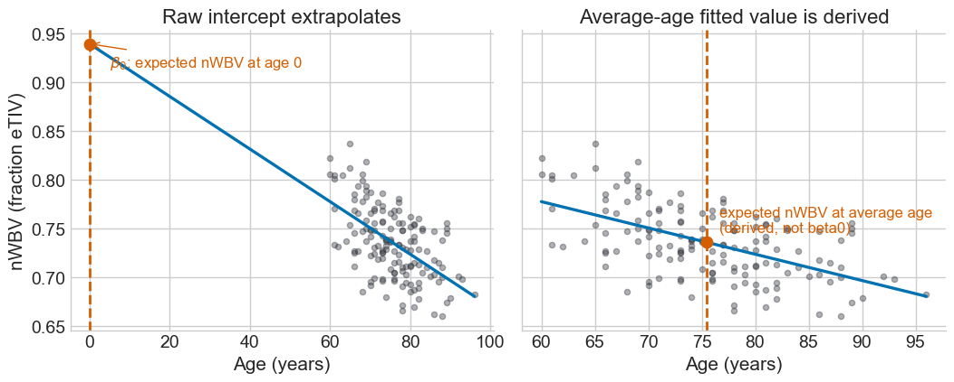
Intercept has different meaning in the two models
Scientific question
Which do you care about?
Statistical question
Which produces stable inference?
Because we can convert between them

Slide 32
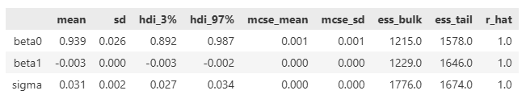
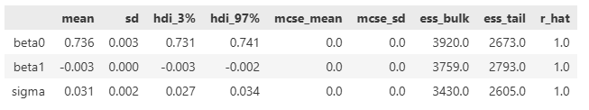
The sampling is slower and less independent
Uncentered independent variable
Centered independent variable
4 chains for 1,000 tune and 1,000 draw iterations
17 seconds
4 chains for 1,000 tune and 1,000 draw iterations
3 seconds

Slide 33
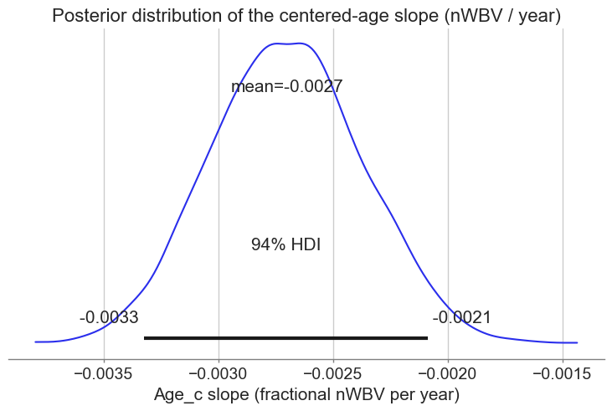
The posterior of the slope is unchanged
Uncentered independent variable
Centered independent variable

Slide 34
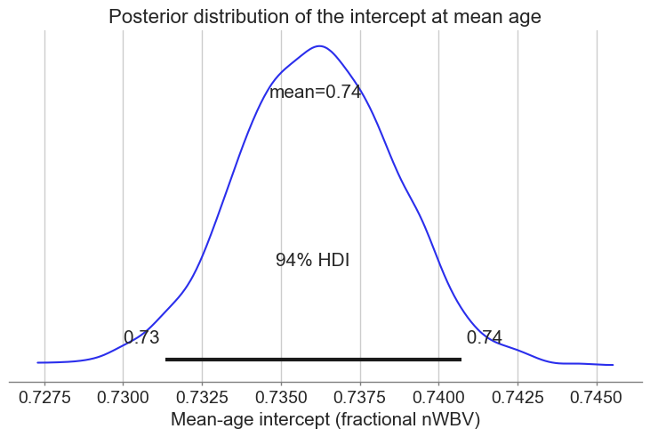
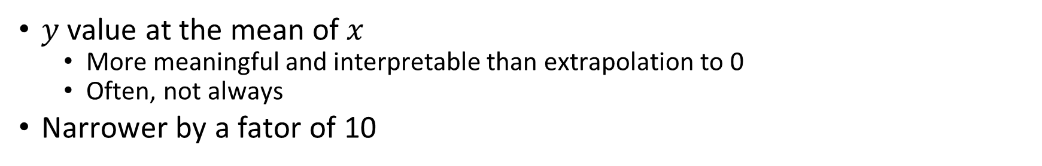
The posterior of the intercept is different
$y$ value at the mean of $x$
More meaningful and interpretable than extrapolation to 0
Often, not always
Narrower by a fator of 10

Slide 35
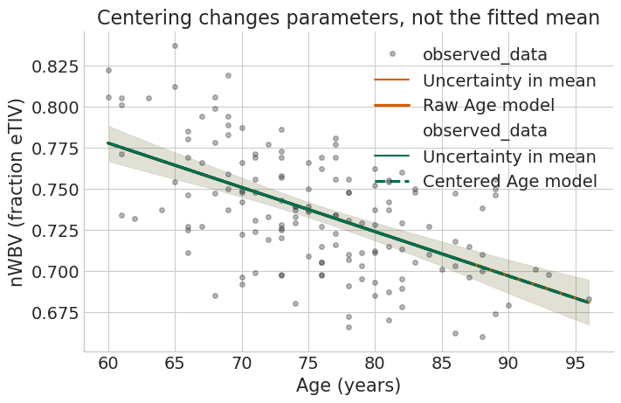
The final fit is the same
Reparameterization affects sampling and interpretability of parameters
Not fit

Slide 36
8.5 Multivariate regression
Multivariate dependencies, the multivariate model with simple and matrix variables, workflow

Slide 37
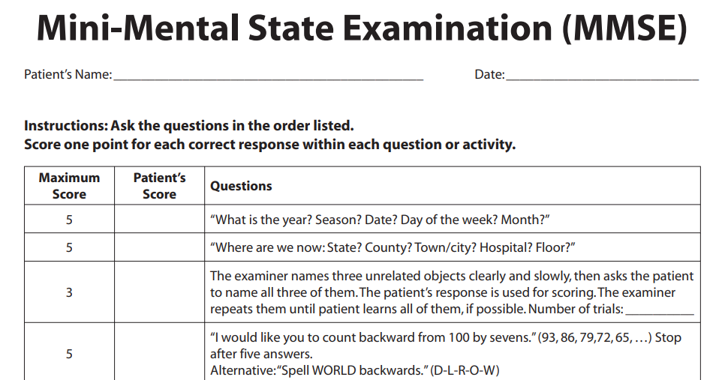
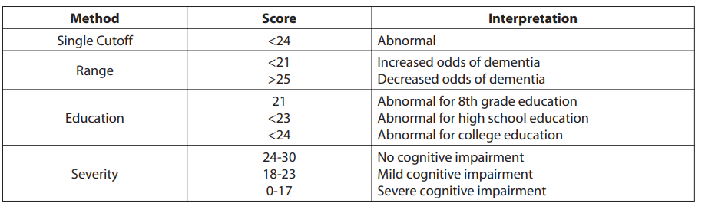
Mini-mental state exam (MMSE)
Widely used in clinical practice and in research

Slide 38
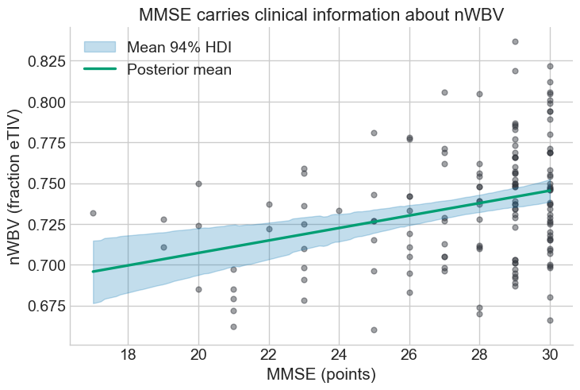
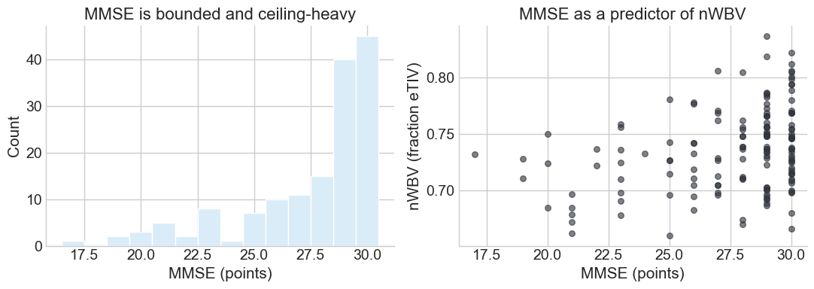
MMSE predicts brain volume
Note that the MMSE is
Ordinal
Bounded
Non-Gaussian
None of this violates the regression model
No assumptions about the independent variable

Slide 39
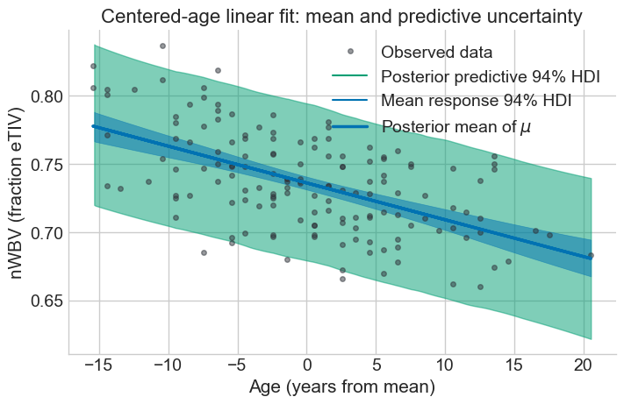
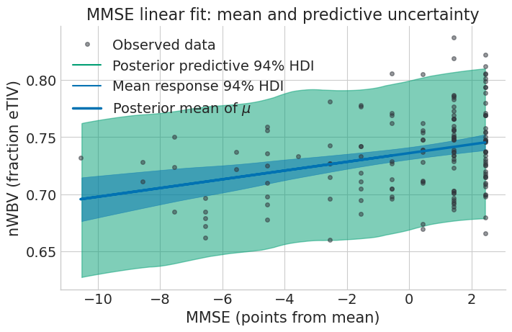
Can we ask about Age and MMSE together?
Treat age and MMSE as two independent variables
Treat nWBV as a dependent variable
Combine into a single model

Slide 40
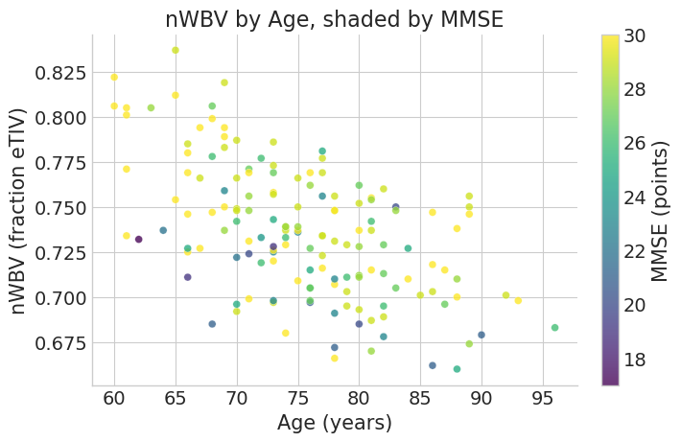
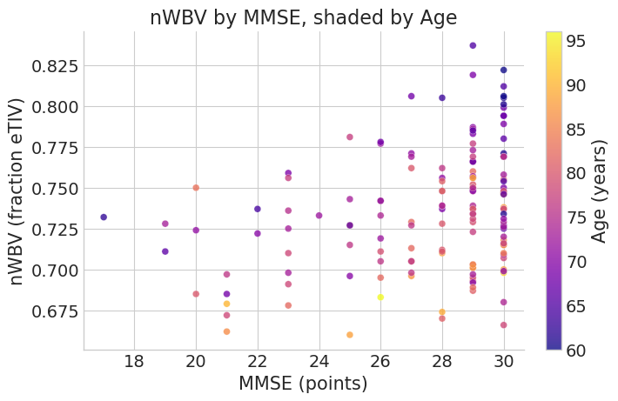
Three dimensional plots can help visualize

Slide 41
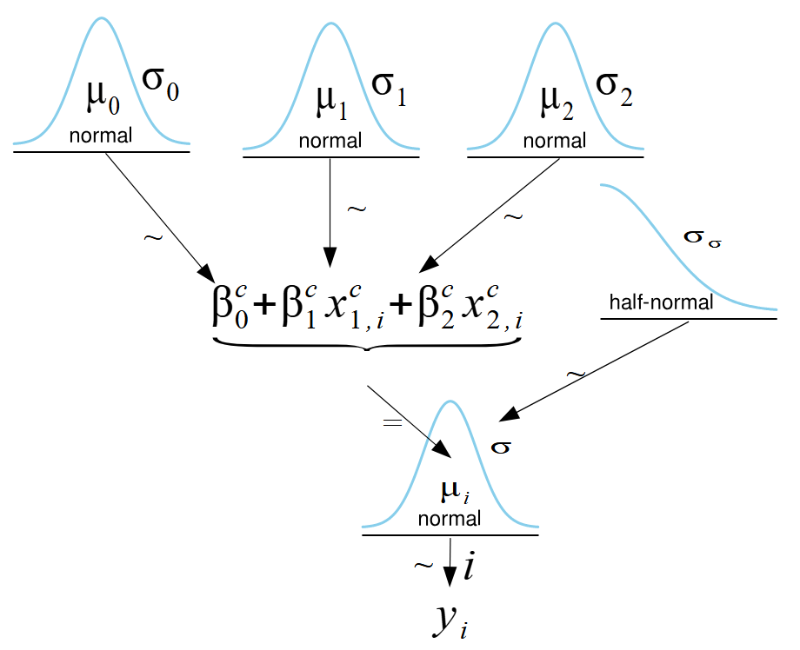
We generalize the bivariate model

Slide 42
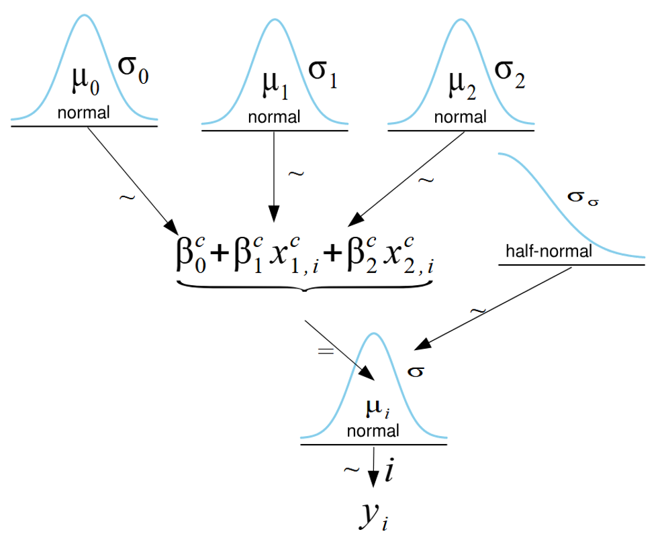
And translate it to PyMC
with pm.Model(coords=coords_multiple) as nwbv_multiple_model:
Age_c_data = pm.Data("Age_c_data", multiple_df["Age_c"].to_numpy(), dims="obs_id")
MMSE_c_data = pm.Data("MMSE_c_data", multiple_df["MMSE_c"].to_numpy(), dims="obs_id")
beta0 = pm.Normal("beta0", mu=mu_beta0, sigma=sigma_beta0)
beta1 = pm.Normal("beta1", mu=mu_beta1, sigma=sigma_beta1)
beta2 = pm.Normal("beta2", mu=mu_beta2, sigma=sigma_beta2)
sigma = pm.HalfNormal("sigma", sigma=sigma_sigma)
mu = pm.Deterministic("mu", beta0 + beta1 * Age_c_data + beta2 * MMSE_c_data, dims="obs_id")
nwbv_obs = pm.Normal("nwbv_obs", mu=mu, sigma=sigma, observed=multiple_df["nWBV"].to_numpy(), dims="obs_id")

Slide 43
We can generalize to matrix notation
with pm.Model(coords=coords) as nwbv_multiple_model:
Age_c_data = pm.Data("Age_c_data", multiple_df["Age_c"].to_numpy(), dims="obs_id")
MMSE_c_data = pm.Data("MMSE_c_data", multiple_df["MMSE_c"].to_numpy(), dims="obs_id")
beta0 = pm.Normal("beta0", mu=mu_beta0, sigma=sigma_beta0)
beta1 = pm.Normal("beta1", mu=mu_beta1, sigma=sigma_beta1)
beta2 = pm.Normal("beta2", mu=mu_beta2, sigma=sigma_beta2)
sigma = pm.HalfNormal("sigma", sigma=sigma_sigma)
mu = pm.Deterministic("mu", beta0 + beta1 * Age_c_data + beta2 * MMSE_c_data, dims="obs_id")
nwbv_obs = pm.Normal("nwbv_obs", mu=mu, sigma=sigma, observed=multiple_df["nWBV"].to_numpy(), dims="obs_id")
with pm.Model(coords=coords) as model_matrix:
X = pm.Data("X", X_matrix, dims=("obs_id", "var"))
beta = pm.Normal("beta", mu=mu_beta, sigma=sigma_beta, dims="var")
sigma = pm.HalfNormal("sigma", sigma=sigma_sigma)
mu = pm.Deterministic("mu", pm.math.dot(X, beta), dims="obs_id")
nwbv_obs = pm.Normal(
"nwbv_obs",
mu=mu,
sigma=sigma,
observed=multiple_df["nWBV"].to_numpy(),
dims="obs_id",
)

Slide 44
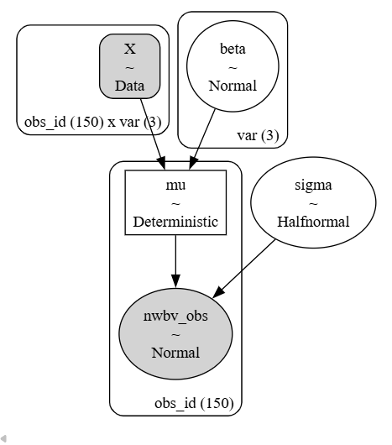
We can generalize to matrix notation
with pm.Model(coords=coords) as model_matrix:
X = pm.Data("X", X_matrix, dims=("obs_id", "var"))
beta = pm.Normal("beta", mu=mu_beta, sigma=sigma_beta, dims="var")
sigma = pm.HalfNormal("sigma", sigma=sigma_sigma)
mu = pm.Deterministic("mu", pm.math.dot(X, beta), dims="obs_id")
nwbv_obs = pm.Normal(
"nwbv_obs",
mu=mu,
sigma=sigma,
observed=multiple_df["nWBV"].to_numpy(),
dims="obs_id",
)

Slide 45
The data matrix holds all the independent variables

Slide 46
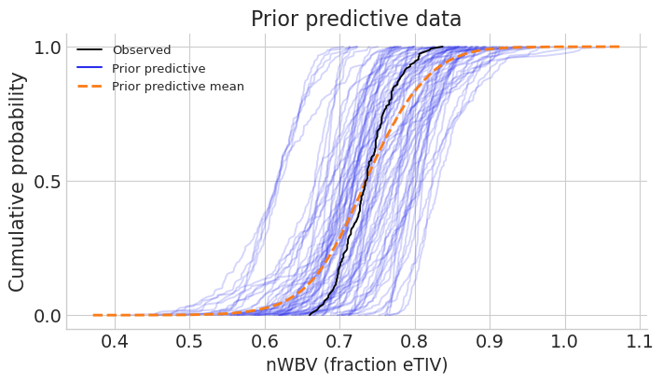
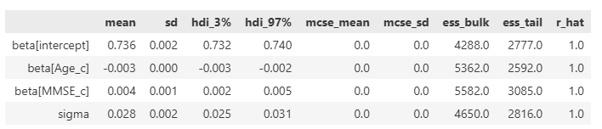
Always do the workflow

Slide 47
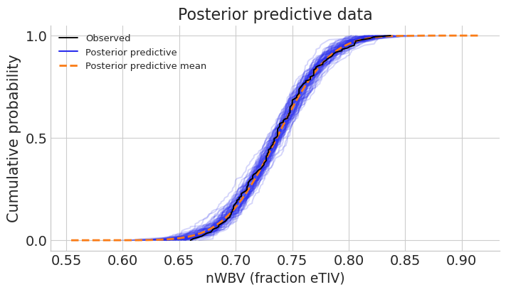
Check goodness of fit

Slide 48
8.6 Multivariate regression posterior

Slide 49
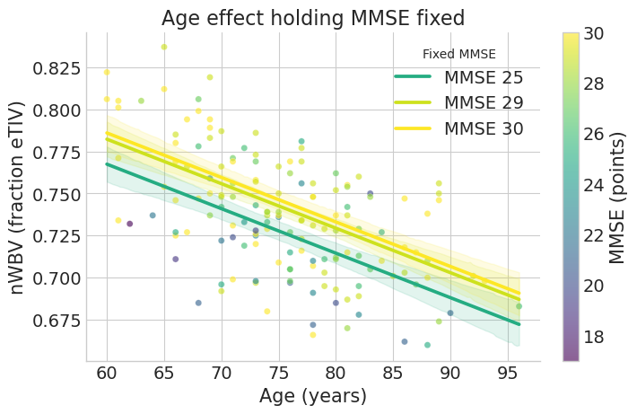

$β_{\text{Age}}$ gives the effect of Age when MMSE is held fixed
nWBV is reduced around 0.25% / year
HDI is 0.2%-0.3%
For different values of MMSE

Slide 50


$β_{\text{MMSE}}$ gives the effect of MMSE when Age is held fixed
nWBV goes up by 0.4% for every point of MMSE
HDI is 2.4%-5.2%
For a given age

Slide 51

The two slope parameters are not correlated
Correlated parameters can be a problem for models
Like with uncentered data

Slide 52

Compare effect sizes using standardized slopes
Compare slopes despite difference in units

Slide 53

Compare HDI and ROPE on standardized effects
Plots show only the HDI without the tails
No overlap with ROPE

Slide 54


Variance explained is used as an effect size
$R^{2}$ divides the variance into two parts:
Variance captured by the model: $\text{var}\left(μ_{i}\right)$
Residual variance in the data: $σ^{2}$
In general: $\text{var}\left(y\right)=\text{var}\left(μ_{i}\right)+σ^{2}$
Although not exactly
$R^{2}$ always increases when new variables are added to the model

Slide 55
8.7 Frequentist methods
Frequentist multivariate model, estimators for regression coefficients, effect sizes, hypothesis tests

Slide 56
The frequentist multivariate regression model
Estimators use Roman letters instead of Greek letters
The estimator can be derived by minimizing the sum squared error
Estimators:
Minimize:

Slide 57

The estimators have a simple formula
$X$ times $y$
Over $X$ times $X$

Slide 58

The sampling distribution of the estimators is normal
They are unbiased
With known variance
That can be estimated
So each estimator $b_{k}$ is normally distributed with known variance that can be estimated

Slide 59


From the sampling distribution we can do statistics
Each $b_{k}$ is normally distributed
So we can get a confidence interval
${b_{i}}/{s_{b_{i}}}$ is distributed with a Student’s t distribution
Under the null hypothesis
With $N−\left(k+1\right)$ degrees of freedom
If there are $k$ independent variables
So we can do a hypothesis test
The standard error (SE) is the standard deviation of the sampling distribution.

Slide 60

Compare frequentist to Bayesian intervals

Slide 61


Frequentist $R^{2}$ to as effect size for regression
Variance explained over total variance
But use only the estimators
Without a distribution

Slide 62
Define some useful statistics
The total variability in the model
The sum squared distance between the model and the mean
The total variability not explained by the model
The squared distance between the data and the model

Slide 63

Count the degrees of freedom
There is a real logic to counting degrees of freedom
We will not learn it
$k$ independent variables

Slide 64



The $F$ statistic can be used for hypothesis tests
The $F$ statistic is a ratio of two measures of variance
Variance from the model in the numerator
Variance for the residuals in the denominator
Under the null model, these two variances should be approximately equal
So the ratio is around 1
With known distribution called the $F$ distribution
Paramaterized by the two degrees of freedom

Slide 65
8.8 Next time
Combining regression with categorical variables

